Slide 1
TOPIC-TMDB MOVIE DATA ANALYSIS
CAPTONE FINAL PROJECTS-SPRINT 2(PYTHON)
NAME: SANJAY SHOME
MENTOR: ASHISH RAJPUT

Slide 2
INDEX
TITLE
SLIDE NO
1) BUSINESS OBJECTIVE
3
2) PYTHON DRIVEN QUESTION
4
3)PYTHON CODING QUESTION
5-11
4) CONCLUSION
12

Slide 3
BUSINESS OBJECTIVE
Genres: Diversification - Explore and expand movie genres to cater to diverse audience preferences and maximize market reach.
Trends: Forecasting - Predict future market trends in the film industry based on historical data analysis, aiding in strategic planning.
Competition: Market Share - Analyze competitor performance to gain insights for capturing and increasing market share in the movie industry.

Slide 4
PYTHON DRIVEN QUESTION
1) Display the number of rows and columns
2)Identify columns with null values
3) Display movie categories with a budget greater than $220,000
4) Display movie categories where revenue is greater than $961,000,000
5) Remove rows with budget and revenue values of 0
6) Top 10 movies with the highest revenues
7) Analyze the correlation between popularity and budget
8) Display names of all production companies and their counts
9) Display names of the top 25 production companies
10) Sort data based on revenue and filter the top 500 movies
11) Identify movies with above-average runtime

Slide 5
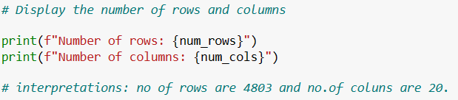
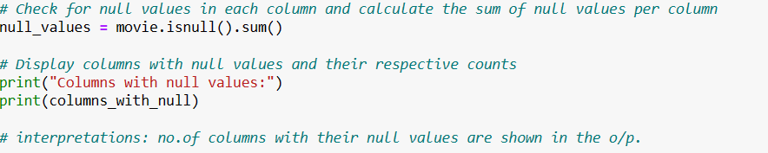

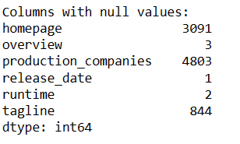
TASK1 Display the number of rows and columns
Task 2 Identify columns with null values
CODE
CODE
OUTPUT
OUTPUT
INTERPRETATIONS
INTERPRETATIONS
NO.OF ROWS-4803
NO.OF COL-20
NO.OF COL WITH NULL VALUES ARE SHOWN IN O/P

Slide 6
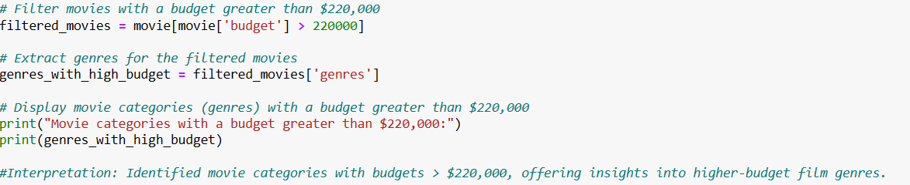
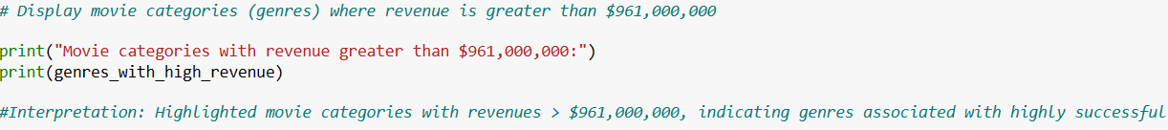
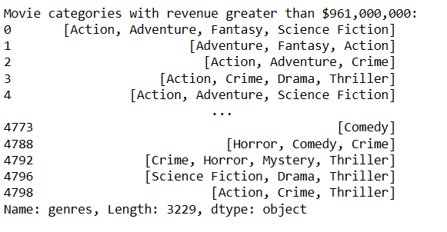
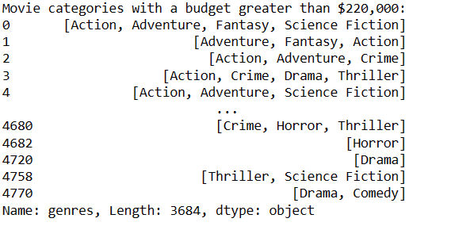
Task 3 movie categories budget > than $220,000
Task 4: movie categories where revenue > than $961,000,000
CODE
CODE
OUTPUT
OUTPUT
INTERPRETATIONS
INTERPRETATIONS
MOVIE CATEGORIES WITH BUDGETS >220,000
MOVIE CATEGORIES REVENUE > $961,000,000

Slide 7
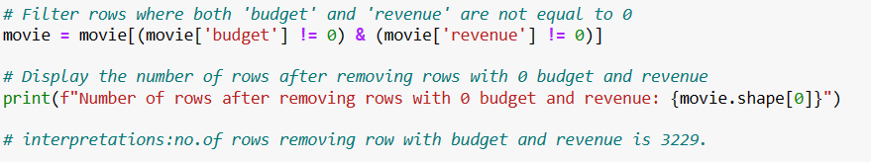
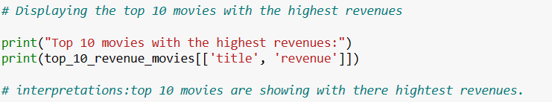
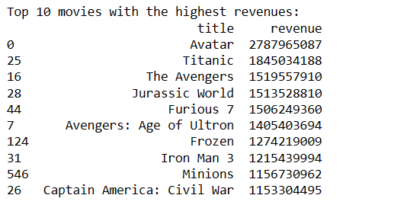
TASK 5:Remove rows with budget and revenue values of 0
TASK 6:Top 10 movies with the highest revenues
CODE
CODE
OUTPUT
INTERPRETATIONS
OUTPUT
INTERPRETATIONS
NO.OF ROWS REMOVING ROWS BUDGET & REVENUE ARE 3229
HIGHTEST REVENUE ON TITLE AND REVENUE COL

Slide 8
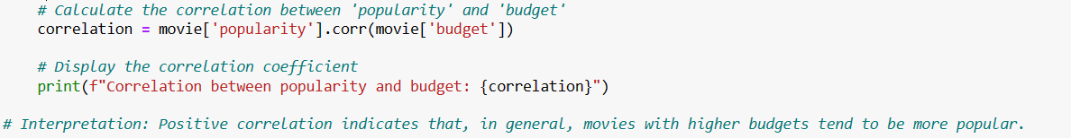
TASK 7):Analyze the correlation between popularity and budget
CODE
INPUT
INTERPRETATIONS
+VE CORRELATION INDICATED WITH THE HIGHTEST BUDGETS TENDS TO BE MORE POPULAR

Slide 9
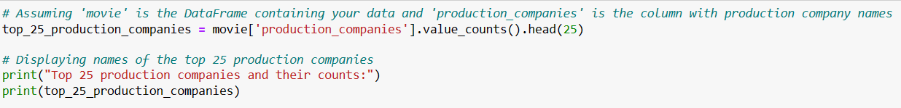
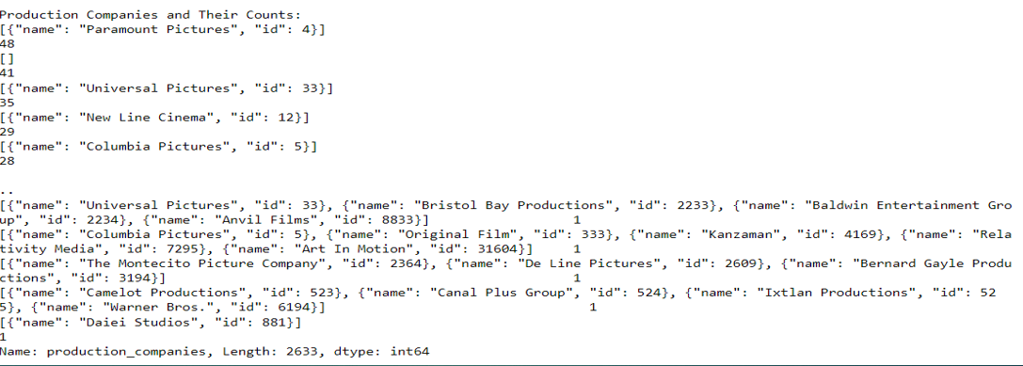

TASK 8):Display names of production companies and their counts
CODE
TASK 9) :Display names of the top 25 production companies
CODE
OUTPUT
OUTPUT
INTERPRETATIONS
INTERPRETATIONS
DISPLAY THE PRODUCTION COMPANIES ALONG WITH THE FEQUENCIES
LIST OF 25 PRODUCTION COMPANIES AND THEIR COUNTS

Slide 10
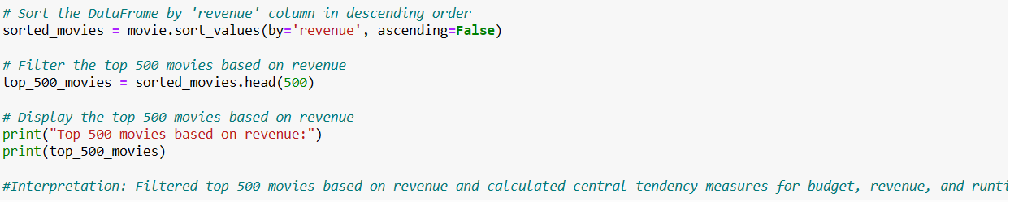
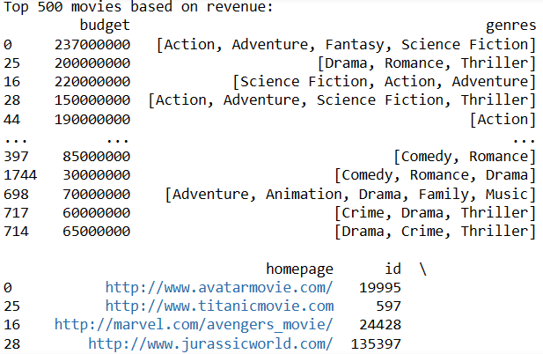
TASK 10):Sort data based on revenue and filter the top 500 movies
CODE
OUTPUT
INTERPRETATIONS
FILTER BASED ON REVENUE,BUDGET,REVENUE 500 MOVIES.

Slide 11
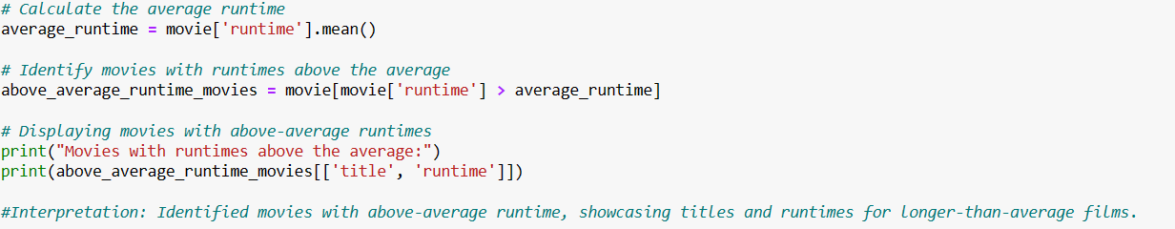
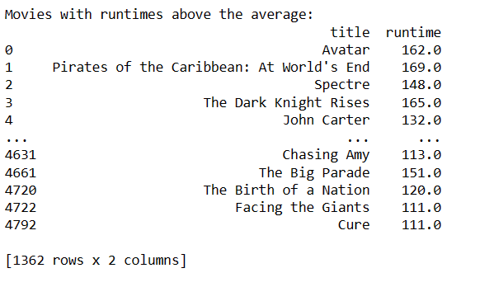
TASK 11):Identify movies with above-average runtime
CODE
OUTPUT
INTERPRETATIONS
THERE ARE 1362 ROWS,2 COLUMNS, ABOVE AVG-RUN TIME

Slide 12
CONCLUSION
By analyzing the TMDB movie dataset provides valuable insights into the trends and patterns .
nature of movie success, which involves various factors beyond budget and genre, revenue budget trends,
Runtime distribution of movies,offering foundation for informed making in film industry.

